Slide 1
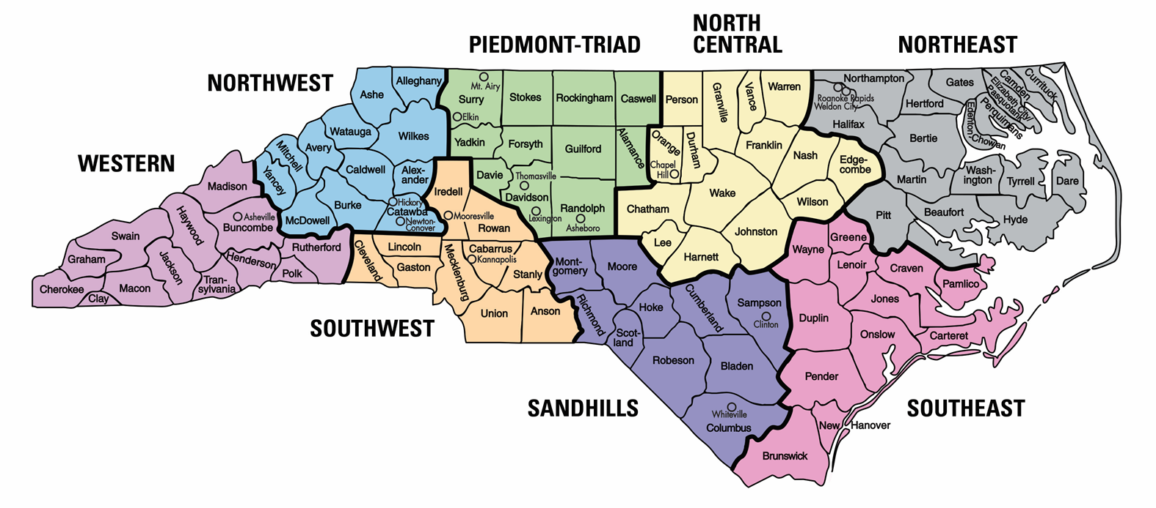
NC DPI School-Based Practice Advisory Council for TBI
Courtney Licklider: School Psychologist (Franklin)
Ashlee Taylor: School Psychologist (Wake)
Stephen Hooper: Neuropsychologist (Orange)
Sherry Todd: School Psychologist (Winston- Salem/Forsyth)
William Walker*: Neuropsychologist (Beaufort)
Kim McClellan: School Psychologist (Currituck)
No representation at this time
Catherine Cuthbertson: School Psychologist (Swain)
Laura Riley: PK School Psychologist (Cabarrus – PK Specific)
JoAnne Garay: School Psychologist (Cabarrus)
No representation at this time
Suzanne Bogle: School Psychologist (Craven)
Maureen Kaniuka: School Psychologist (New Hanover)
DPI:
Dreama McCoy: Section Chief, Supporting Teaching and Related Services,
NC DPI, Exceptional Children Division
Lynn Makor: Consultant for School Psychology,
NC DPI Exceptional Children Division
*On Council for Consultation Only

