Slide 1
What happens next? Building resilience to support students with autism spectrum disorder in making a successful transition to postsecondary education
Debra Childress, Ph.D.
2015 CIDD Community Talk Series
March 11, 2015

Slide 2
3C Institute
Mission
Improve lives of children & families by closing research to practice gap
Philosophy
Create usable, engaging, easy to implement, rigorously tested products that integrate with service settings
Grant: Dynamic e-learning to improve postsecondary transition outcomes for secondary students with high functioning autism; PI: Deb Childress
Funded by grants for the U.S. Department of Education SBIR program (ED-IES-13-C-0026)

Slide 3
Learning objectives
Describe some of the common challenges/concerns that students may experience as they transition to postsecondary education
Learn how resilience supports success
Generate a list of topics to review with your support network

Slide 4
Common Concerns & Challenges

Slide 5
The research shows the stress level of college students typically increases significantly during their first year of college, and that first- and second-year students experience more stress, anxiety, and depression than upper classmen.

Slide 6
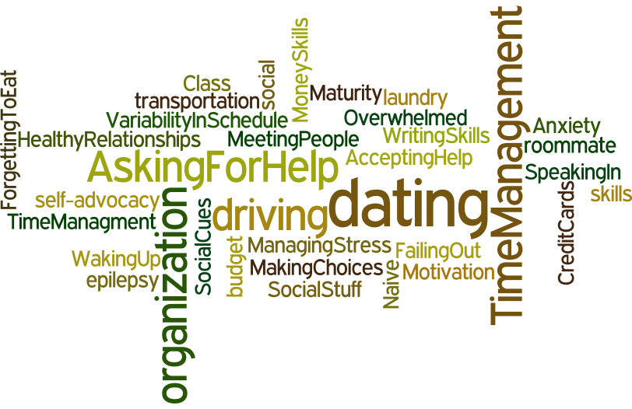
Parents’ Concerns

Slide 7
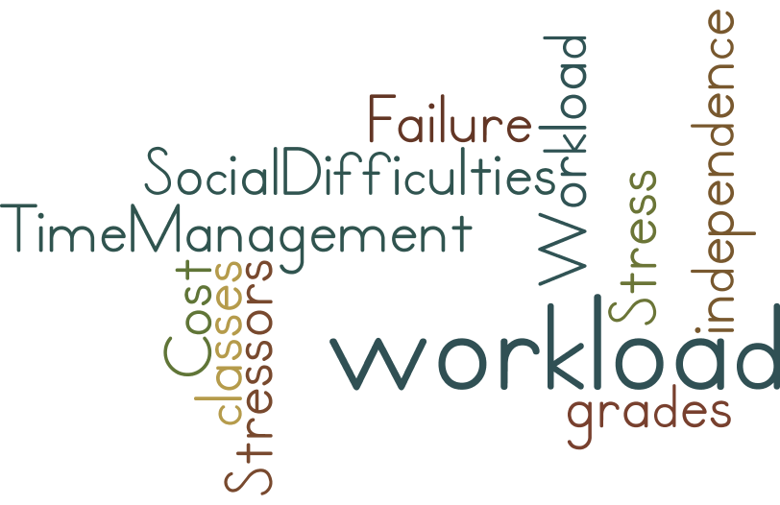
High School Students’ Concerns
Notes:
Do these match your concerns?
What are your concerbs

Slide 8
Resilience

Slide 9
What is resilience?
The ability to adjust to circumstances and keep going in the face of adverse or changing circumstances….major or minor.
Resilience helps us take on challenges and embrace new experiences.
A lack of resilience can lead to anxiety, poor self-care, depression, and risky behaviors, such as substance abuse.

Slide 10
What makes a person resilient?
A variety of factors are associated with resilience, including healthy relationships, good self care, and an optimistic outlook.
Resilient people use this skill set to respond to problems more effectively and balance life’s demands.
They’re confident in their ability to handle any situation, better able to cope with stress, and more likely to achieve their goals.

Slide 11
Do resilient people experience less adversity?
No. Resilient people experience difficult situations and unpleasant emotions, but they’re able to cope more effectively and bounce back faster.

Slide 12
Can anyone be resilient?
Yes. Resilience is an essential skill that you can learn and develop. We can all become more resilient, regardless of our upbringing or current circumstances.

Slide 13
Resilience in Students
PsycInfo, ERIC, PubMed show no articles on resilience of students with ASD

Slide 14
My Resilience Factors
The people that I have to support me when times are tough
Self Care
The way I take care of my body: physically, mentally and emotionally
Life Skills
My ability to cope, flexibility, and self-regulation
Cognitive Style
Social Connections
The way I think about myself, my success and failure

Slide 15
Life Skills | Doesn’t sound like Me | Sounds like Me
1. I love learning. | □ | □
2. I laugh a lot and have a good sense of humor. | □ | □
3. I do very well at school in my core subjects. | □ | □
4. I’m independent and can think for myself. | □ | □
5. I’m flexible and able to adapt to changing circumstances. | □ | □
6. I can easily understand the thoughts and feelings of others. | □ | □
8. I’m creative. | □ | □
7. I’m self-motivated to succeed. | □ | □
9. I can control my emotions and behavior, even when upset. | □ | □
10. I’m a leader and others often look to me for leadership. | □ | □
11. I often succeed because I don’t give up. | □ | □

Slide 16
Self-Care | Doesn’t sound like Me | Sounds like Me
1. I exercise regularly. | □ | □
2. I do things that are fun for me. | □ | □
3. I have non-school related hobbies I do regularly. | □ | □
4. I stand up for myself. | □ | □
5. I eat a healthy (e.g. low fat) diet. | □ | □
6. I do NOT abuse any substances (caffeine, alcohol, or other drugs). | □ | □
7. Most nights of the week, I sleep 7-9 hours. | □ | □

Slide 17
Cognitive Style | Doesn’t sound like Me | Sounds like Me
1. I’m confident in my ability to succeed. | □ | □
2. I like myself. | □ | □
3. I believe I’ll be able to succeed in school. | □ | □
4. When bad things happen, I know things will get better. | □ | □
5. If I try, I can achieve pretty much anything. | □ | □
6. I’m able to set realistic goals for myself. | □ | □

Slide 18
Social Connections | Doesn’t sound like Me | Sounds like Me
1. I’m happy with the quality of my friendships. | □ | □
2. I’m an active member of an extracurricular school group or team. | □ | □
3. I volunteer my time to service in the community. | □ | □
4. I feel socially connected to others. | □ | □
5. I feel connected to something bigger than myself. | □ | □
6. I have close, positive relationships with my family. | □ | □

Slide 19
How do students and parents view student resilience?

Slide 20
How do students and parents view student resilience?
Who are we missing here?

Slide 21
Social Connections | Doesn’t sound like Me | Sounds like Me
1. I’m happy with the quality of my friendships. | □ | □
2. I’m an active member of an extracurricular school group or team. | □ | □
3. I volunteer my time to service in the community. | □ | □
4. I feel socially connected to others. | □ | □
5. I feel connected to something bigger than myself. | □ | □
6. I have close, positive relationships with my family. | □ | □

Slide 22
Information and Skills

Slide 23
Build Resilience
Notes:
Manage stress. Identify your sources of stress and how they affect you. Once you understand how your behavior changes in response to stress (e.g., your health suffers, you isolate yourself from others), you can modify unhealthy or unproductive reactions and develop coping strategies for your vulnerable areas.
Examine your thoughts. Negative or inaccurate thoughts about ourselves, others, or the future can produce unhelpful emotions and behaviors. Increase your awareness of how you interpret events so you can challenge and alter counterproductive thoughts and develop a more adaptive thinking style.
Build a support network. Positive social connections provide assistance, guidance, and comfort during difficult times. Strengthen your relationships with family, friends, and trusted others to form a support network. The quality of these relationships is more important than the quantity.
Take care of yourself. Pay attention to how you take care of your physical, mental, and emotional health, including your attitude toward yourself. Whether it's avoiding health hazards, managing your time better, or simply being kind to yourself, find ways to enhance your self-care in each area of health. No one area is more important than another; strive for balance.
Pursue your goals. Setting goals provides us with purpose and direction. Pursue goals that are meaningful to you. When your goals, and therefore your behaviors, align with your strengths and values, you're more likely to succeed.

Slide 24
Build Resilience
Springboard tips
Help your teen realize that stressful situations call for support, learn how to recognize his/her stress signals, and identify the people that he/she can contact for support.
Ask your teen to start the day by saying three positive things about him/herself to build the belief that he/she can handle challenges.
Remind your teen of the things that he/she has accomplished. Together talk about the strengths that he/she has to support success during the transition to college.

Slide 25
Support Self-Advocacy
Notes:
Faculty and staff of postsecondary programs expect that your teen will be his/her own advocate for academic and social needs. Parent involvement is quite limited at the PSE level, and this can be a big surprise and change to both parents and teens, as parents are often the primary advocate for educational needs through high school. Self-advocacy includes teens speaking up for themselves, recognizing when they need help, understanding their rights, and understanding their abilities and disability.

Slide 26
Support Self-Advocacy
Springboard tips
Your teen should understand his/her abilities, set goals, and take steps to achieve these goals. Have your teen make a list of his/her current responsibilities and set goals about which responsibilities he/she can start to do more independently.
Talk with your teen about self-advocacy and help him/her gain more independence during the high school years. Empower your teen by supporting activities in which you know he/she can be successful independently.
Notes:
Faculty and staff of postsecondary programs expect that your teen will be his/her own advocate for academic and social needs. Parent involvement is quite limited at the PSE level, and this can be a big surprise and change to both parents and teens, as parents are often the primary advocate for educational needs through high school. Self-advocacy includes teens speaking up for themselves, recognizing when they need help, understanding their rights, and understanding their abilities and disability.

Slide 27
Explore Early
Notes:
Faculty and staff of postsecondary programs expect that your teen will be his/her own advocate for academic and social needs. Parent involvement is quite limited at the PSE level, and this can be a big surprise and change to both parents and teens, as parents are often the primary advocate for educational needs through high school. Self-advocacy includes teens speaking up for themselves, recognizing when they need help, understanding their rights, and understanding their abilities and disability.

Slide 28
Explore Early
Springboard tips
Help your teen make a chart of the different types of PSE options. Together evaluate factors such as: cost, distance from home, admission requirements, availability of supports, program duration, and size of the school. Discuss how different programs match your teen’s academic goals.
Help your teen make a list of programs/schools that he/she would like to attend. Examine those specific schools for the factors listed above by exploring the school website.
Setup a campus tour. Seeing the campus can ease anxiety and point out areas for further exploration.
Notes:
Certificate programs or technical schools, two-year or community colleges, and four-year colleges or universities…with so many PSE options, students are often overwhelmed by or under- or misinformed about the options available to them. This can lead to inaction or indecisiveness at a critical time.

Slide 29
Discuss Disability Services
Notes:
Unlike in high school, technical schools and colleges are not required to seek out students who need extra help, even if they have a disability. To receive accommodations, your teen will need to disclose his/her disability to the disability services office and work with them to determine which services they may qualify for.

Slide 30
Discuss Disability Services
Springboard tips
Talk with your teen about the pros and cons of disclosing his/her disability. Be sure to discuss how disclosure doesn’t have to be all or nothing (you can share information about your disability with only certain people).
Begin to collect documentation such as reports that list your teen’s current diagnosis, how his/her disability affects any major life activity, how the disability affects his/her academic performance, and a copy of his/her recent IEP.
When admitted, have your teen check with disability services to obtain a complete list of the procedures and required documentation for applying for services, as this varies by school.
Notes:
Unlike in high school, technical schools and colleges are not required to seek out students who need extra help, even if they have a disability. To receive accommodations, your teen will need to disclose his/her disability to the disability services office and work with them to determine which services they may qualify for.

Slide 31
Make Social Connections
Notes:
Supportive relationships are integral to resilience. During major life transitions, like going to college, people often have to work hard to meet new people and build their social connections. It is not surprising that in our conversations with students with ASD, making friends and a fear of loneliness is the number one college transition concern. But here’s the good news: everyone who is making the transition to college is in the same situation, trying to establish connections and find a place to fit in, so opportunities for new friendships are plentiful.

Slide 32
Make Social Connections
Springboard tips
Develop a plan with your teen for how he/she can join in by exploring special interest clubs at schools that fit with his/her personal interests. When you join a special interest club, you will automatically have something to talk about!
Ask your teen to assess if he/she is giving welcoming social cues. Is his body language and verbal communication sending the right message to others?
Discuss how your teen will maintain his/her existing social network and how this network can still be helpful during the college transition.
Acknowledge that while building social connections takes effort, and that not every attempt at meeting new people will be successful, college is a new start and an excellent opportunity to meet a new group of people who share his/her interests, thoughts, and experiences.
Notes:
Supportive relationships are integral to resilience. During major life transitions, like going to college, people often have to work hard to meet new people and build their social connections. It is not surprising that in our conversations with students with ASD, making friends and a fear of loneliness is the number one college transition concern. But here’s the good news: everyone who is making the transition to college is in the same situation, trying to establish connections and find a place to fit in, so opportunities for new friendships are plentiful.

Slide 33
Questions for Educators/Guidance Counselor
How can I take a larger role in establishing IEP and transition plan goals?
What are local PSE programs that are particularly good at supporting students with ASD?
What IEP goals do you recommend to help me establish independent learning and advocacy skills?
When can we start developing my transition portfolio?
What do you see as my strengths going into PSE?

Slide 34
https://www.youtube.com/watch?v=BCRK7-ZnRvs&feature=youtu.be
Notes:
Motivating employees can be a tough balance between both intrinsic and extrinsic factors. Sometimes we becomes so focused on using things such as money and other rewards that the they can become a much bigger focus than the work itself. That is an outcome you wish to avoid. They key components of motivating your team are the listed bullet points.
We will talk about each process but first are there other points you can think of to motivate your team?

Slide 35
Design Process Overview
Initial Prototype Development
Feasibility Testing
Architecture & Interface Revisions
Student Iterative Testing
Provider Usability Testing
Prototype & Website Revisions
Consultant Expertise
Pilot Testing in Schools
Revisions for Commercialization
Commercial Launch
To learn more or possibly participate in the development of PREP, contact Deb at childress@3cisd.com

Slide 36
Thank you!
Contact information: Deb Childress, Ph.D.
childress@3cisd.com; (919) 677-0102 ext 515
Funded in part by grants for the U.S. Department of Education SBIR program (ED-IES-13-C-0026)

